Slide 1

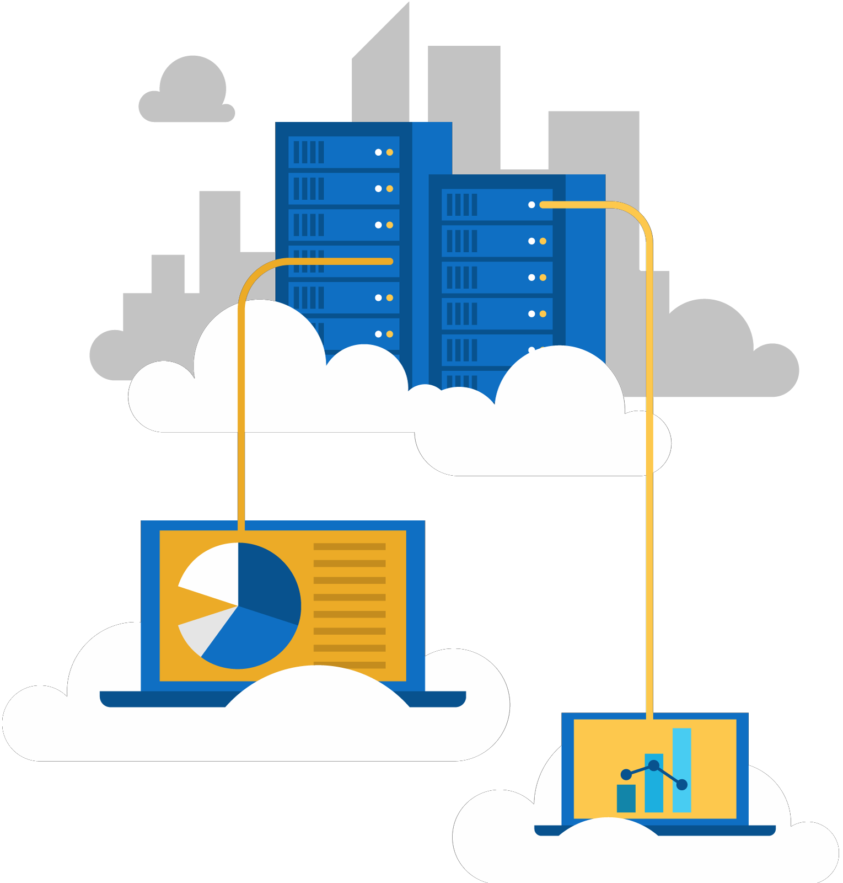




Jordan Radkov
Cloud Solution Architect

Slide 2
Series Agenda
1 | Determine Workload Requirements (10-15%)
2 | Design for Identity and Security (20-25%)
3 | Design a Data Platform Solution (15-20%)
4 | Design a Business Continuity Strategy (15-20%)
5 | Design for Deployment, Migration, and Integration (10-15%)
6 | Design an Infrastructure Strategy (15-20%)

Slide 3
Series Agenda
1 | Determine Workload Requirements (10-15%)
2 | Design for Identity and Security (20-25%)
3 | Design a Data Platform Solution (15-20%)
4 | Design a Business Continuity Strategy (15-20%)
5 | Design for Deployment, Migration, and Integration (10-15%)
6 | Design an Infrastructure Strategy (15-20%)

Slide 4



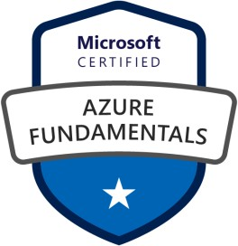



Jordan Radkov
Cloud Solution Architect based in the Munich
10+years in the industry in infrastructure administration , automation and now cloud
Constant learner - Ancora Imparo

Slide 5
Objectives
Design a Storage Strategy
design a storage provisioning strategy design storage access strategy identify storage requirements
recommend a storage solution and storage management tools
Design a Compute Strategy
design compute provisioning and secure compute strategies
determine appropriate compute technologies (e.g., virtual machines, functions, service fabric, container instances, etc.)
design an Azure HPC environment identify compute requirements
recommend management tools for compute

Slide 6
Objectives (Cont.)
Design a Networking Strategy
design network provisioning and network security strategies determine appropriate network connectivity technologies identify networking requirements
recommend network management tools
Design a Monitoring Strategy for Infrastructure
design for alert notifications
design an alert and metrics strategy

Slide 7
Design a Storage Strategy

Slide 9
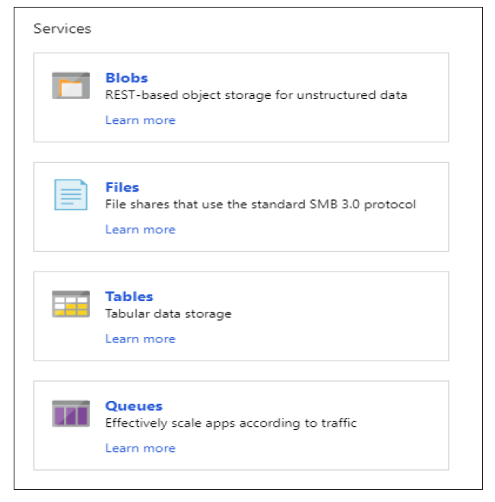








Slide 10
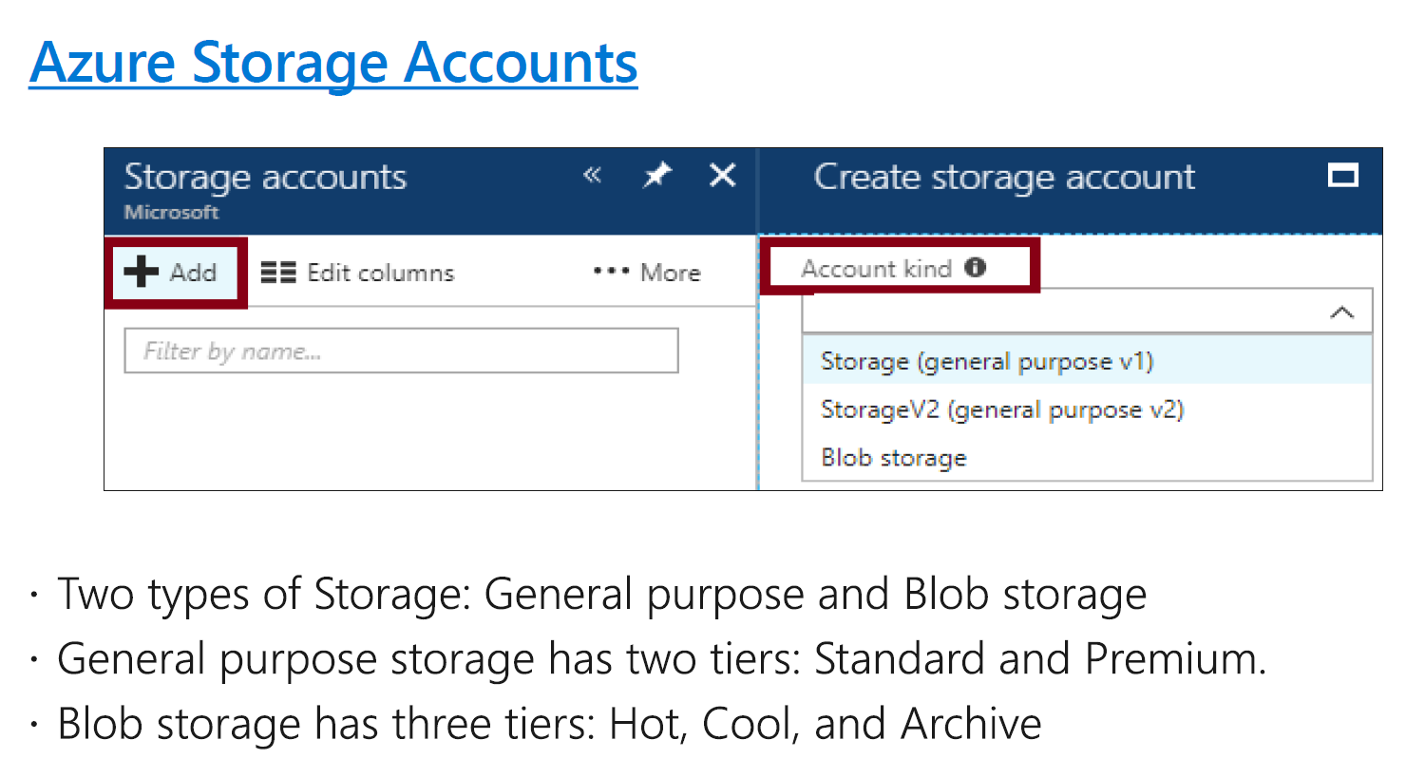

Slide 11
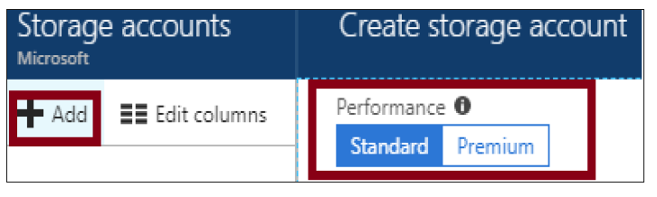





Slide 12






Slide 13

Configuring Custom Domain Names
CNAME record | Target
blobs.contoso.com | contosoblobs.blob.core.windows.net
CNAME record | Target
asverify.blobs.contoso.com | asverify.contosoblobs.blob.core.windows.net
blobs.contoso.com | contosoblobs.blob.core.windows.net

Slide 14

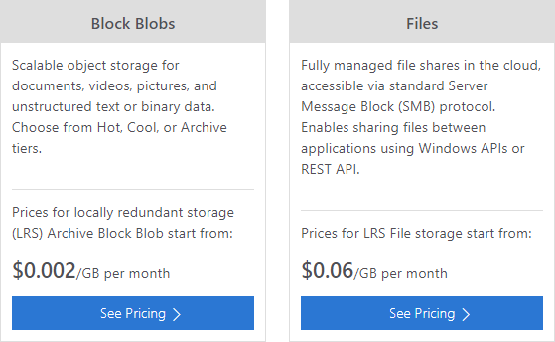




Slide 15
How to create a GPv2 storage account
How to convert a GPv1 or Blob storage account to a GPv2 storage account
How to set the account in a GPv2 storage account
How to set a blob tier in a Blob storage or GPv2 storage account

Slide 16


Slide 17




Slide 18

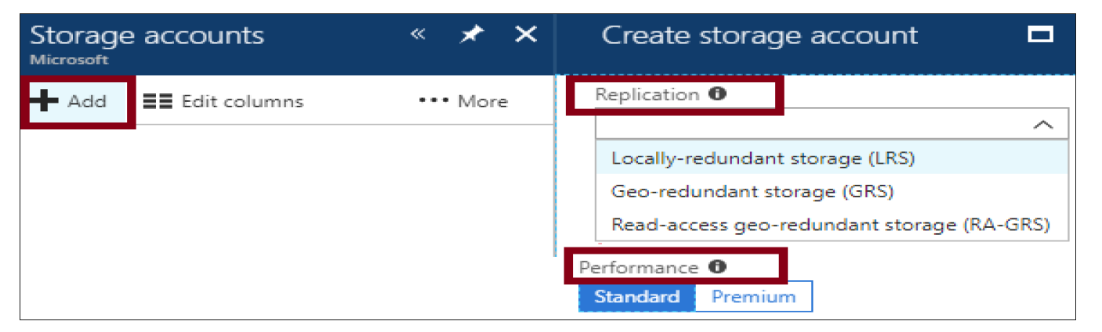

Slide 19


Locally Redundant Storage
Replication | Copies | Strategy
Locally redundant storage (LRS) | Maintains three copies of your data. | Data is replicated three time within a single facility in a single region.

Slide 20


Replication | Copies | Strategy
Geo-redundant storage (GRS) | Maintains six copies of your data. | Data is replicated three times within the primary region and is also replicated three times in a secondary region hundreds of miles away from the primary region.
Read access geo- redundant storage (RA-GRS) | Maintains six copies of your data. | Data is replicated to a secondary geographic location and provides read access to your data in the secondary location.
GRS
RA-GRS

Slide 21
Replication | Copies | Strategy
Zone- redundant storage (ZRS) | Maintains three copies of your data. | Data is replicated three times across two to three facilities, either within a single region or across two regions.

Slide 22
Replication Option | LRS | ZRS | GRS | RA-GRS
Node unavailability within a data center | Yes | Yes | Yes | Yes
An entire data center (zonal or non-zonal) becomes unavailable | No | Yes | Yes | Yes
A region-wide outage | No | No | Yes | Yes
Read access to your data (in a remote, geo-replicated region) for region-wide unavailability | No | No | No | Yes
Available in storage account types | GPv1, GPv2, Blob | Standard, GPv2 | GPv1, GPv2, Blob | GPv1, GPv2, Blob

Slide 23
Task | Example
Check to see if a storage account name is available. | Get-AzureRmStorageAccountNameAvailability -Name 'mystorageaccount'
Create a storage account. | New-AzureRmStorageAccount -ResourceGroupName MyResourceGroup -AccountName mystorageaccount - Location westus -SkuName Standard_GRS
Retrieve a specific storage account or all the storage accounts in a resource group or subscription. | Get-AzureRmStorageAccount -ResourceGroupName "RG01" -AccountName "mystorageaccount"
Modify storage account properties, such as type. | Set-AzureRmStorageAccount -ResourceGroupName "MyResourceGroup" -AccountName "mystorageaccount" -Type "Standard_RAGRS"

Slide 24


Slide 25



Slide 26
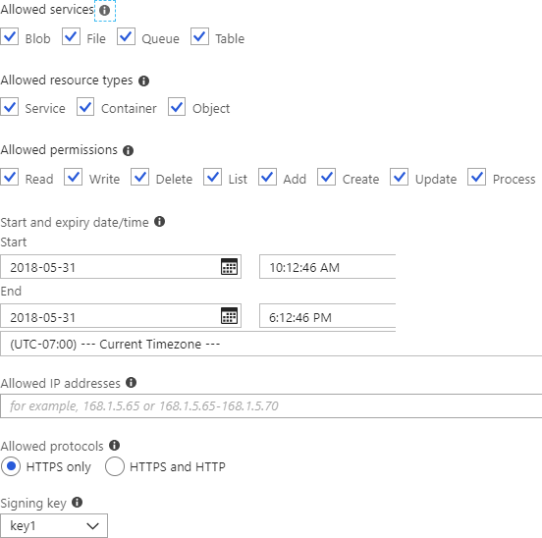
New-AzureStorageAccountSASToken
-Service Blob,File,Table,Queue
-ResourceType Service,Container,Object
-Permission "racwdlup"
New-AzureStorageBlobSASToken
-Container "ContainerName"
-Blob "BlobName"
-Permission rwd

Slide 27
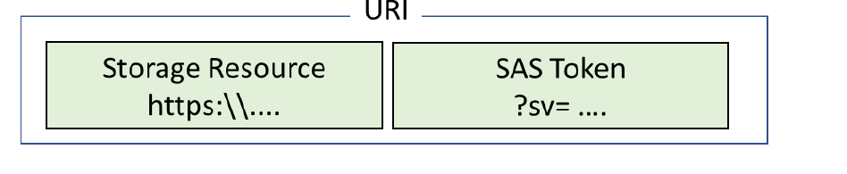

Slide 28


Slide 30

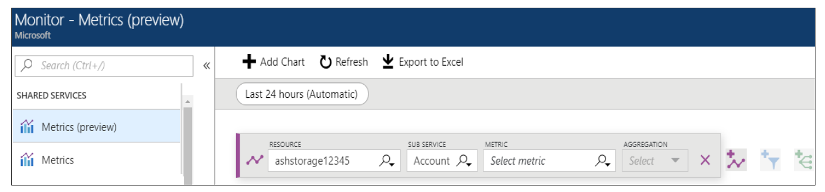

Slide 31
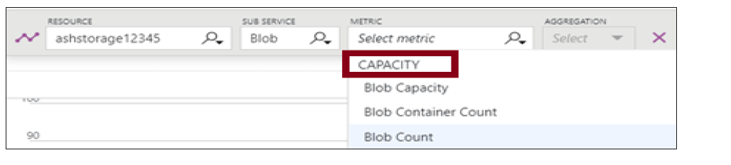

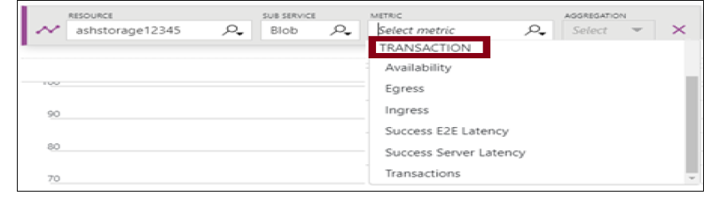

Slide 32
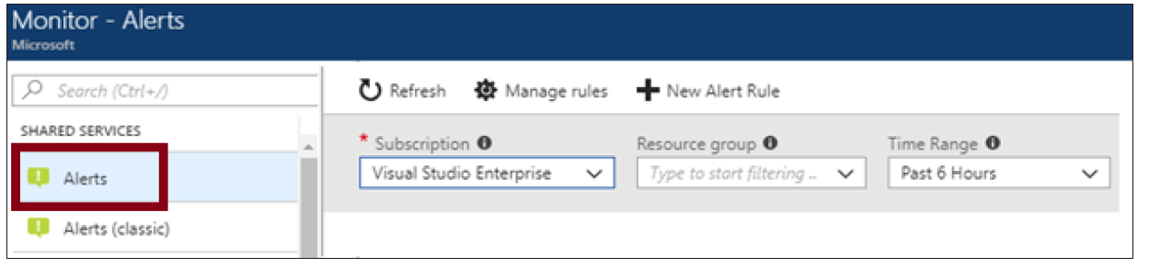


Slide 33

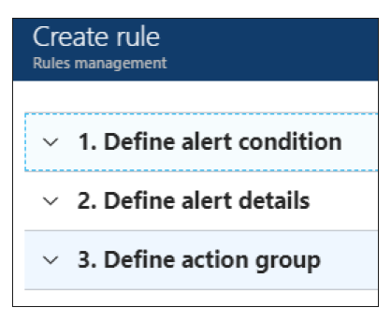








Slide 34

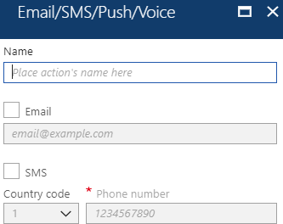
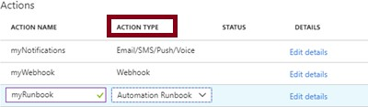


SMS
Logic App Webhook
IT Service Management

Slide 35
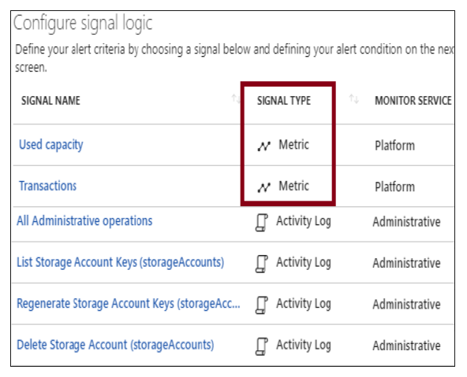









Slide 36








Slide 37
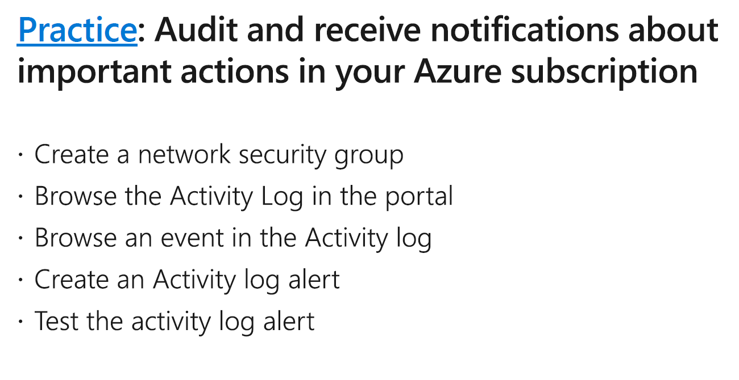

Slide 38



Slide 39

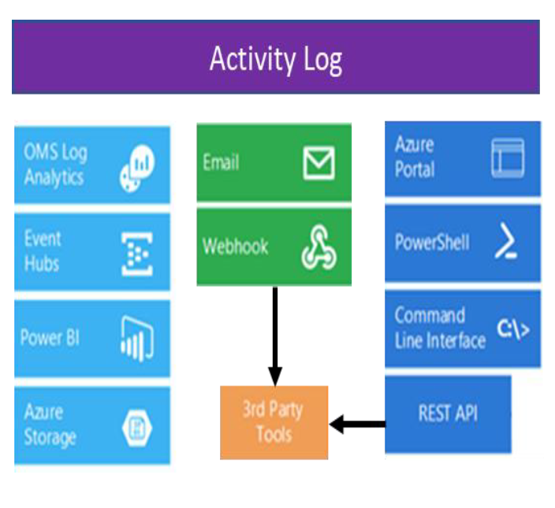



Slide 40

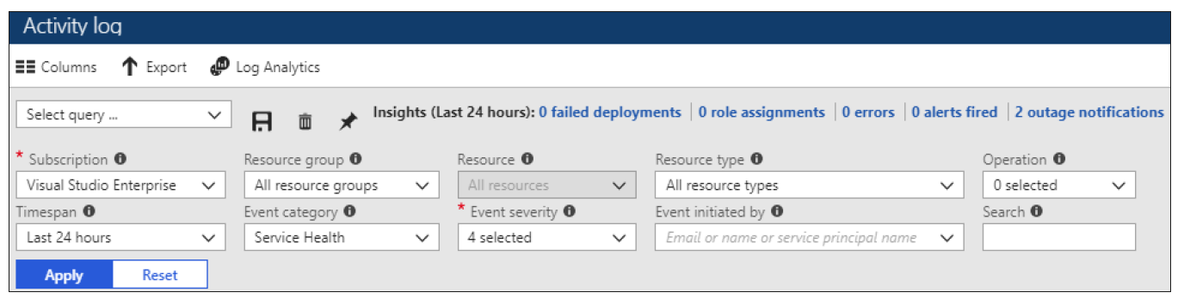

Slide 41

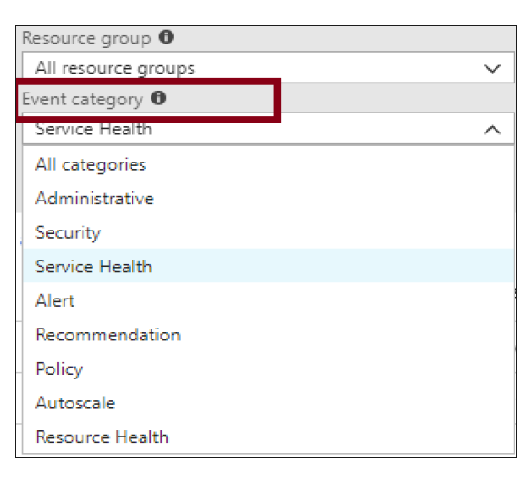








Slide 42


Slide 43
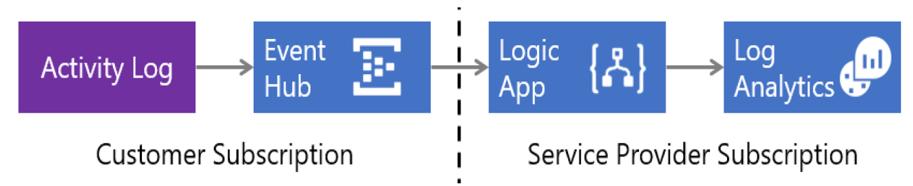



Slide 45


Slide 46





Slide 47
Connect to an Azure subscription Work with local development storage Attach to external storage
Attach a storage account by using an SAS Attach a service by using an SAS
Connect to an Azure Cosmos DB account by using a connection string

Slide 48
Design a Compute Strategy

Slide 49


Slide 50


Slide 51


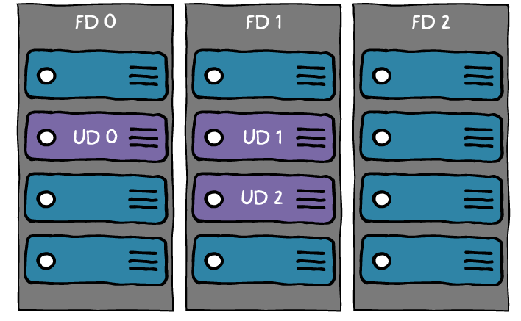




Slide 52


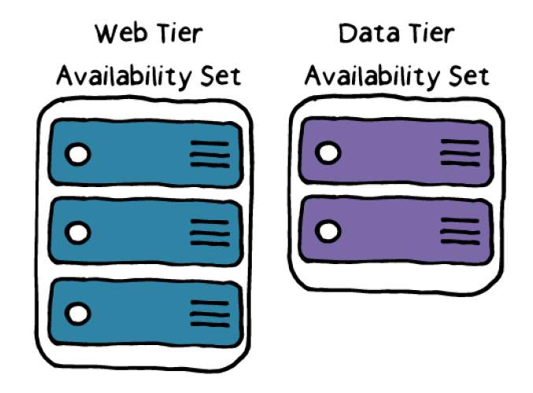

Slide 53

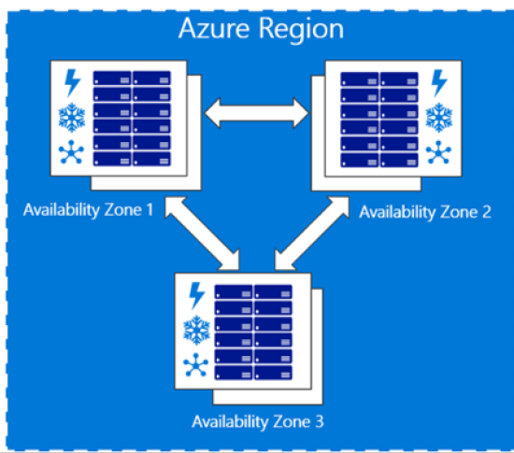




Slide 55



Slide 56
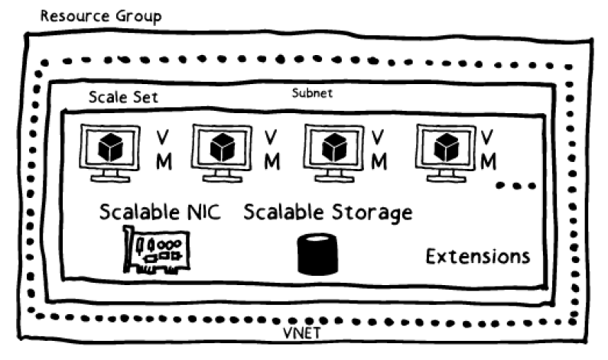

Slide 57





Slide 58
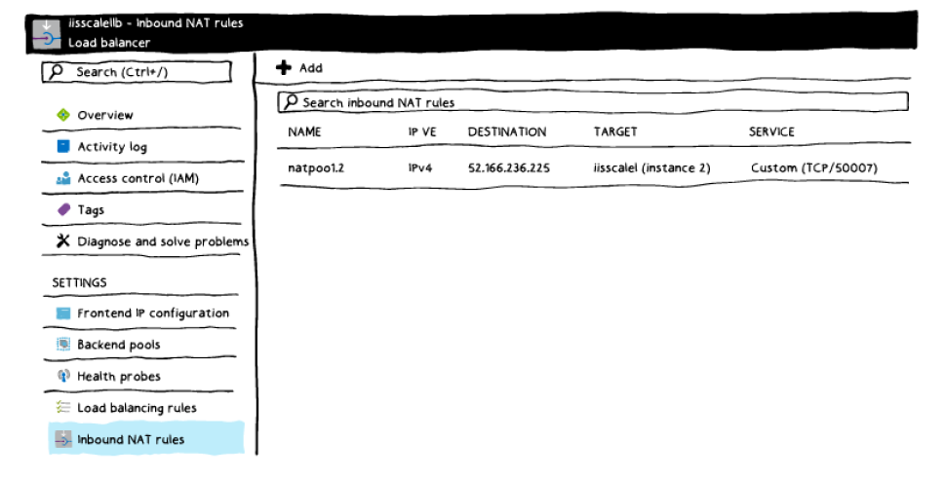

Slide 59
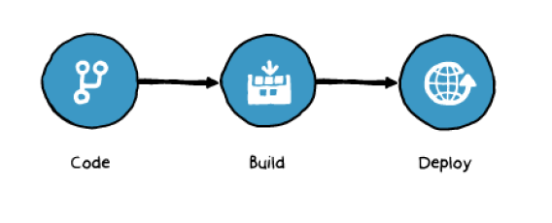




Slide 60







Slide 61


Slide 62



Slide 63

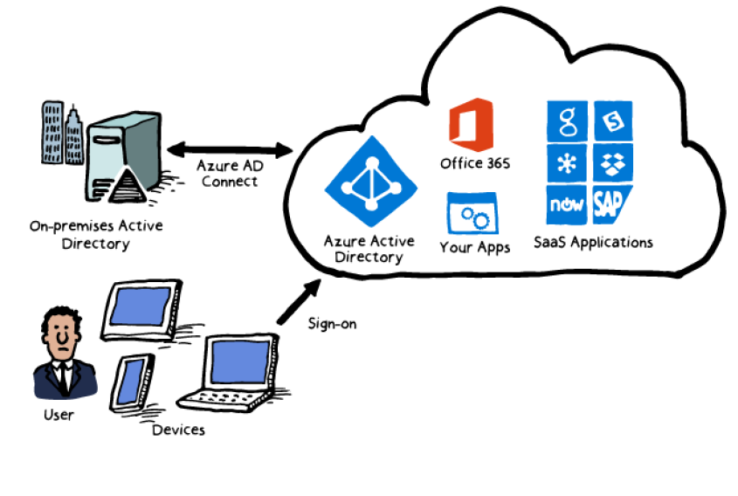


Slide 64





Slide 65


Slide 66





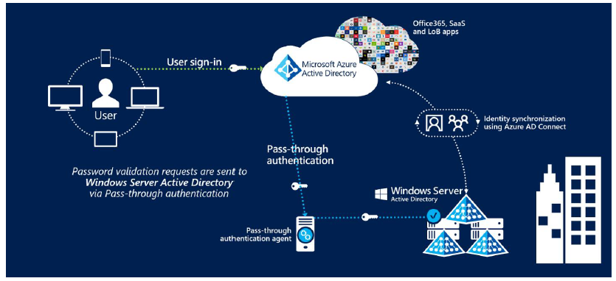








Slide 67
Design a Networking Strategy

Slide 68


Slide 69



Slide 70
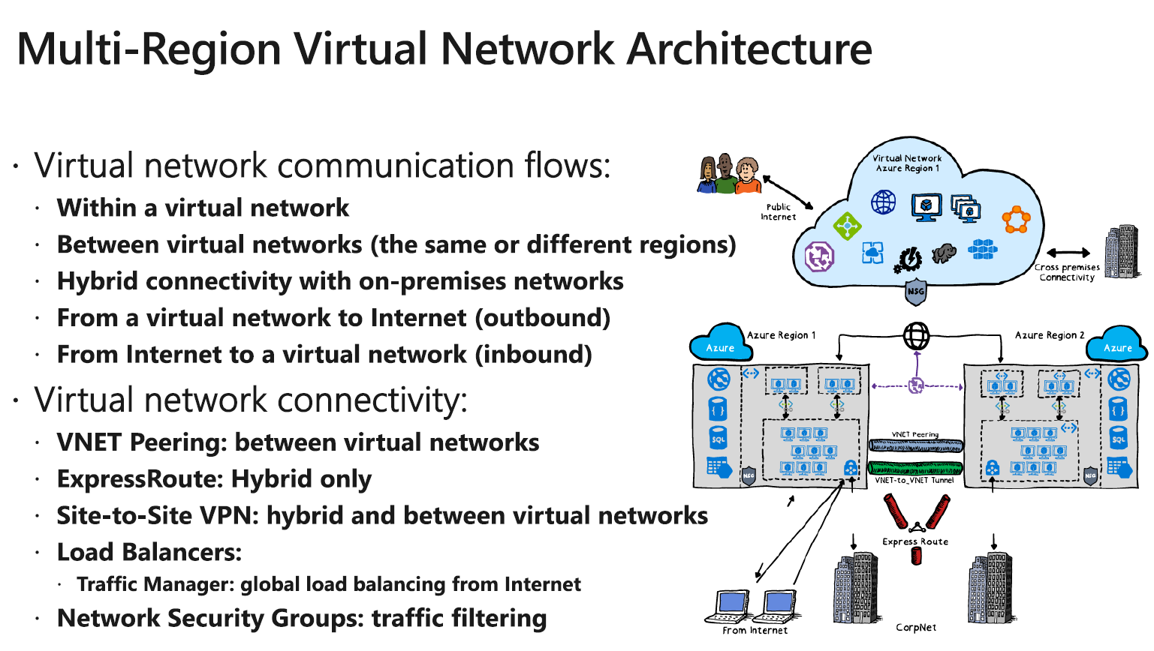






Slide 71






Slide 72


Slide 73



Slide 74










Slide 75

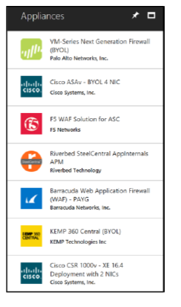
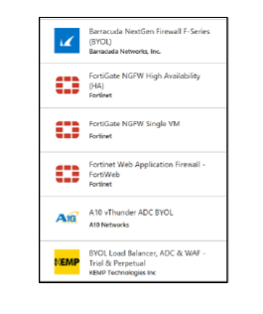



Slide 76
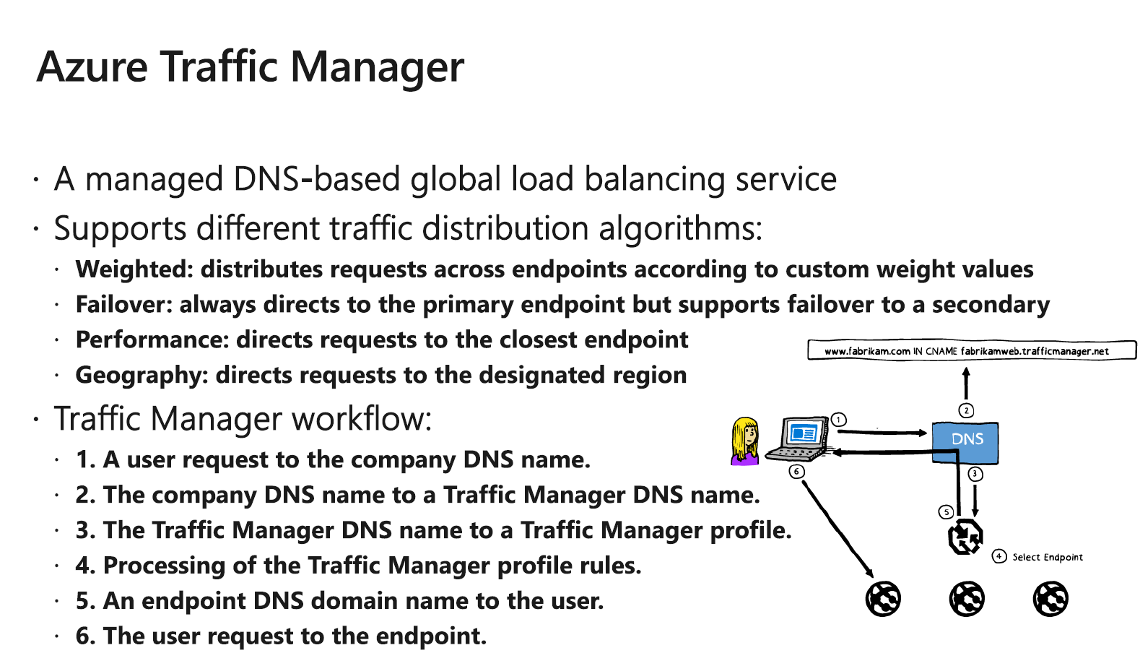



Slide 77


Slide 78


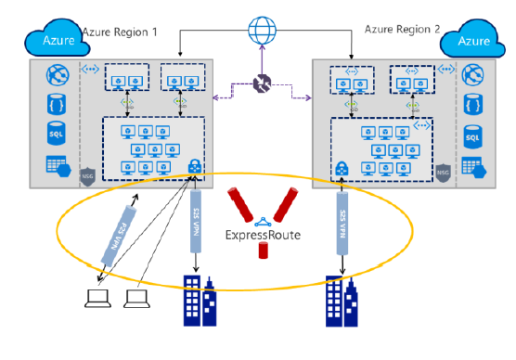












Slide 79



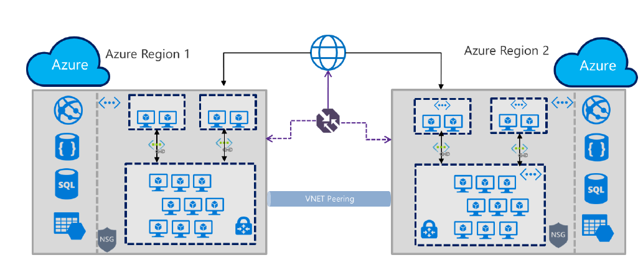


Slide 80


Slide 81




Slide 82
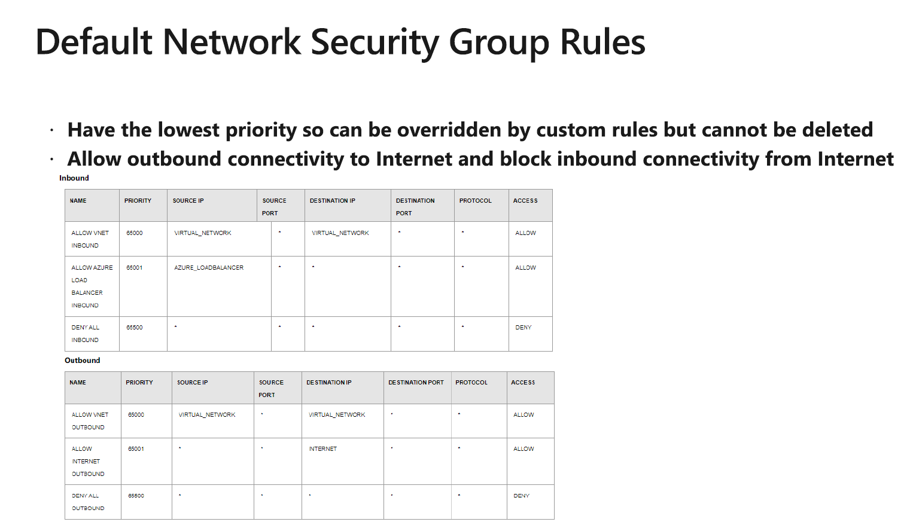

Slide 83








Slide 84
Design a Monitoring Strategy for Infrastructure

Slide 85


Slide 86







Slide 87
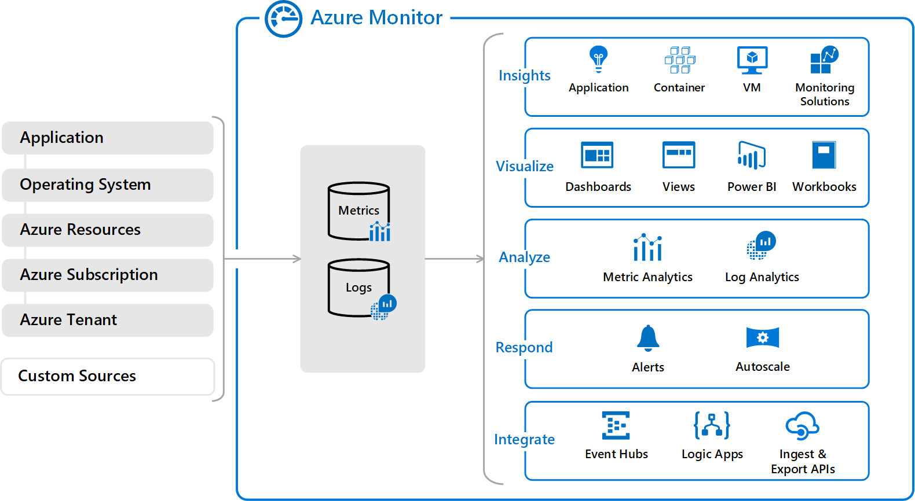

Slide 88
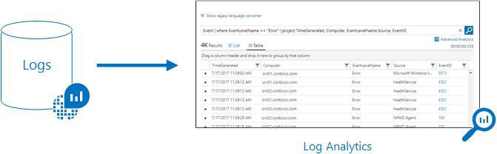
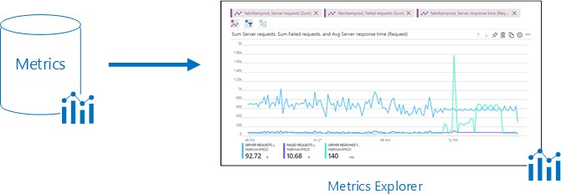

Slide 90

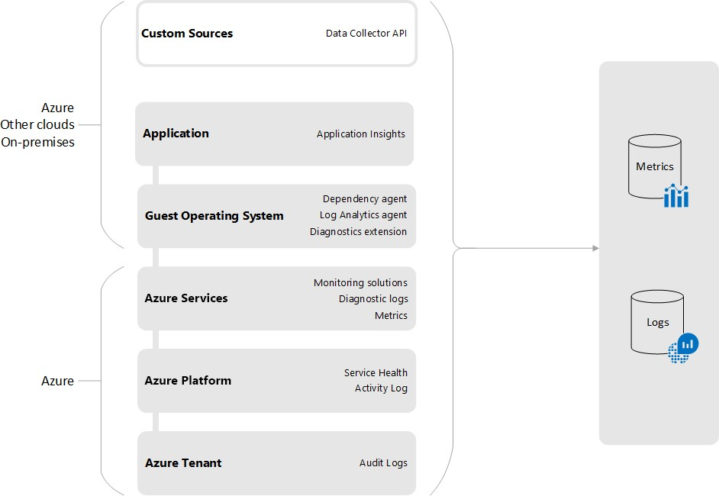

Slide 91





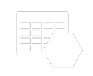




Autoscale
Notifications Engine
Application Insights
Resource
Log Analytics
Metrics
Event Hubs
Azure Storage
Azure Infrastructure
Azure Portal
Azure PowerShell
Azure CLI
REST API
3rd Party Tools

Slide 92

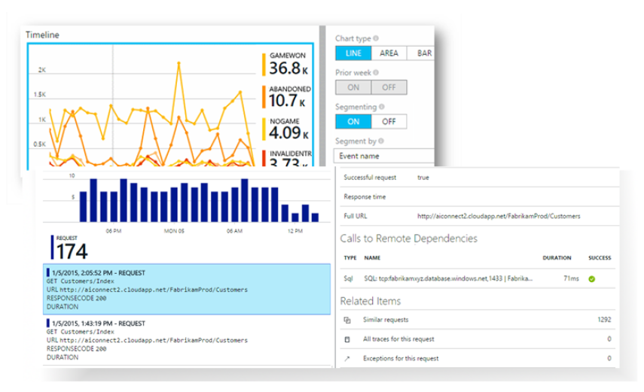







Slide 93


Slide 94




Slide 95





Web Applications _{AI}
Alerts
Application
Insights
Power BI
HTTP Requests
AI
Server-Side
Code
Visual Studio
REST API
Dependency Calls
External
Services
Continuous Export
Background
Services
AI

Slide 96

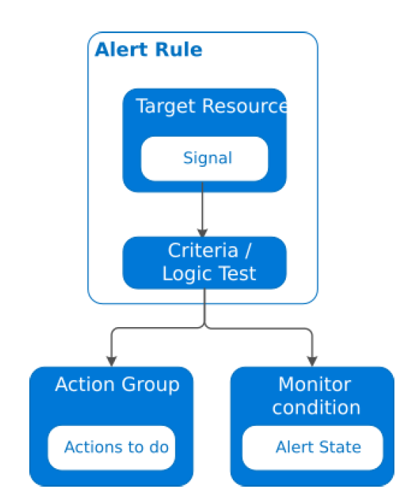





Slide 97



Resource
OMS Alerts
Diagnostic Logs
Azure Monitor Alerts
Rule
Resource Metrics
Criteria Met
Automation
Email
Automation Runbook
SMS
Webhook
Function
Activity Logs
Logic App
Azure Infrastructure
3rd Party URL

Slide 98

State | Description
New | The issue has just been detected and has not yet been reviewed.
Acknowledged | An administrator has reviewed the alert and started working on it.
Closed | The issue has been resolved. After an alert has been closed, you can reopen it by changing it to another state.

Slide 99


Slide 100








Slide 101






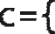

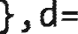






































Slide 102











Slide 103










Slide 104





Slide 105












Slide 106






Slide 107





Slide 108
















Slide 109





















Slide 110




Slide 111






Slide 112

Questions?

